Slide 1
Evaluation
Cognitive Walkthrough
1

Slide 2
Learning goals
Explain discount usability evaluation methods
Outline the general procedure for conducting a cognitive walkthrough
Describe the pros/cons of cognitive walkthroughs
3

Slide 3
Discount usability testing
Cheap (thus ‘discount’)
No special labs or equipment needed
Doesn’t need to involve users directly
The more careful you are, the better it gets
Fast
On order of 1 day to apply
Standard usability testing may take a week
Easy to use
Can be taught in hours
4

Slide 4
Types of discount methods
Cognitive walkthrough: “mental model”
Assesses “exploratory learning stage”
Done by non-experts and/or domain experts
Heuristic evaluation: “fine tune”
Fine-tunes the interface (hi-fi prototypes; deployed systems)
HCI professionals apply a list of heuristics while simulating task
execution
Targets broader use range (including expert)
5

Slide 5







Acquiring mental models During system usage: The user’s own activity leads to a mental model Explanatory theory, developed by the user Often used to predict future behavior of the system Observing others using the system: Casual observation of others working Asking someone else to “do this for me” Formal training sessions Reading about a system Documentation, help screens This is done by the user (not the designer)
Cognitive Walkthrough and mental model
Assessing…
Is the conceptual model an effective one?
Does the interface design communicate the conceptual model?
How well does it support forming a good mental model?
conceptual
mental
model
model
designer
user
system
system
i.e. your prototype
image
7

Slide 6
How to conduct a cognitive walkthrough evaluation?
Start: with a scenario
1) break task down into user actions (expected system response)
2) perform each step ON the existing interface and ask:
Q1: will the user know what to do?
Q2: will the user see how to do the action?
Q3 :will the user correctly understand the system response?
3) if you locate a problem, mark it & pretend it has been repaired; then go on to
next step.
9

Slide 7
Basic steps
Step I. Generate “correct”, intended steps to complete a task
Select a task to be performed and write down all the ‘user actions’, and expected
“system responses”
” (a) can they find correct sequence(s) in current version?
use high-level directives: correct user action
(b) are there mental-model problems even if they use exactly the right sequence?
get very specific: correct user action
11

Slide 8
Basic steps
Step II. Carry out steps, simulating the mindset of your intended user, and note
your success OR failure on a log sheet.
for each step:
Q1: ask yourself if user knows what to do?
Q2: explore – will the user see how to do the step?
Q3: interpret – will the user correctly understand the system response?
Is the feedback understandable? Will the interpretation be correct?
Note: even with an error, user may have progressed if error became apparent.
Distinguish this from when user is left with a misunderstanding.
12

Slide 9
What kinds of problems should I record?
In a CW you may note many kinds of problems, for example:
Problems with particular steps
Larger problems that involve lots of steps
model/design
Other kinds of problems that just become apparent while using
interface, etc.
Make note of these as appropriate
problems that works for you
14

Slide 10
What kinds of problems should I record?
In a CW you may note many kinds of problems, for example:
Problems with particular steps
Larger problems that involve lots of steps
model/design
Other kinds of problems that just become apparent while using
interface, etc.
Make note of these as appropriate
problems that works for you
14

Slide 11
Heuristic evaluation
What for:
Identifying (listing & describing) problems with existing prototypes (any kind of interface); for any kind of user, new or proficient
Cost-benefit:
Usability engineering activities are often expensive / slow; but some can be quick / cheap, and still produce useful results
Focused less on what is “correct” than on what can be done within
development constraints
Ultimate trade-off may be between doing no usability assessment and doing some kind

Slide 12
Individuals vs. teams
Nielsen recommends individual evaluators inspect the interface alone. evaluation is not influenced by others
independent and unbiased
greater variability in the kinds of errors found
no overhead required to organize group meetings

Slide 13
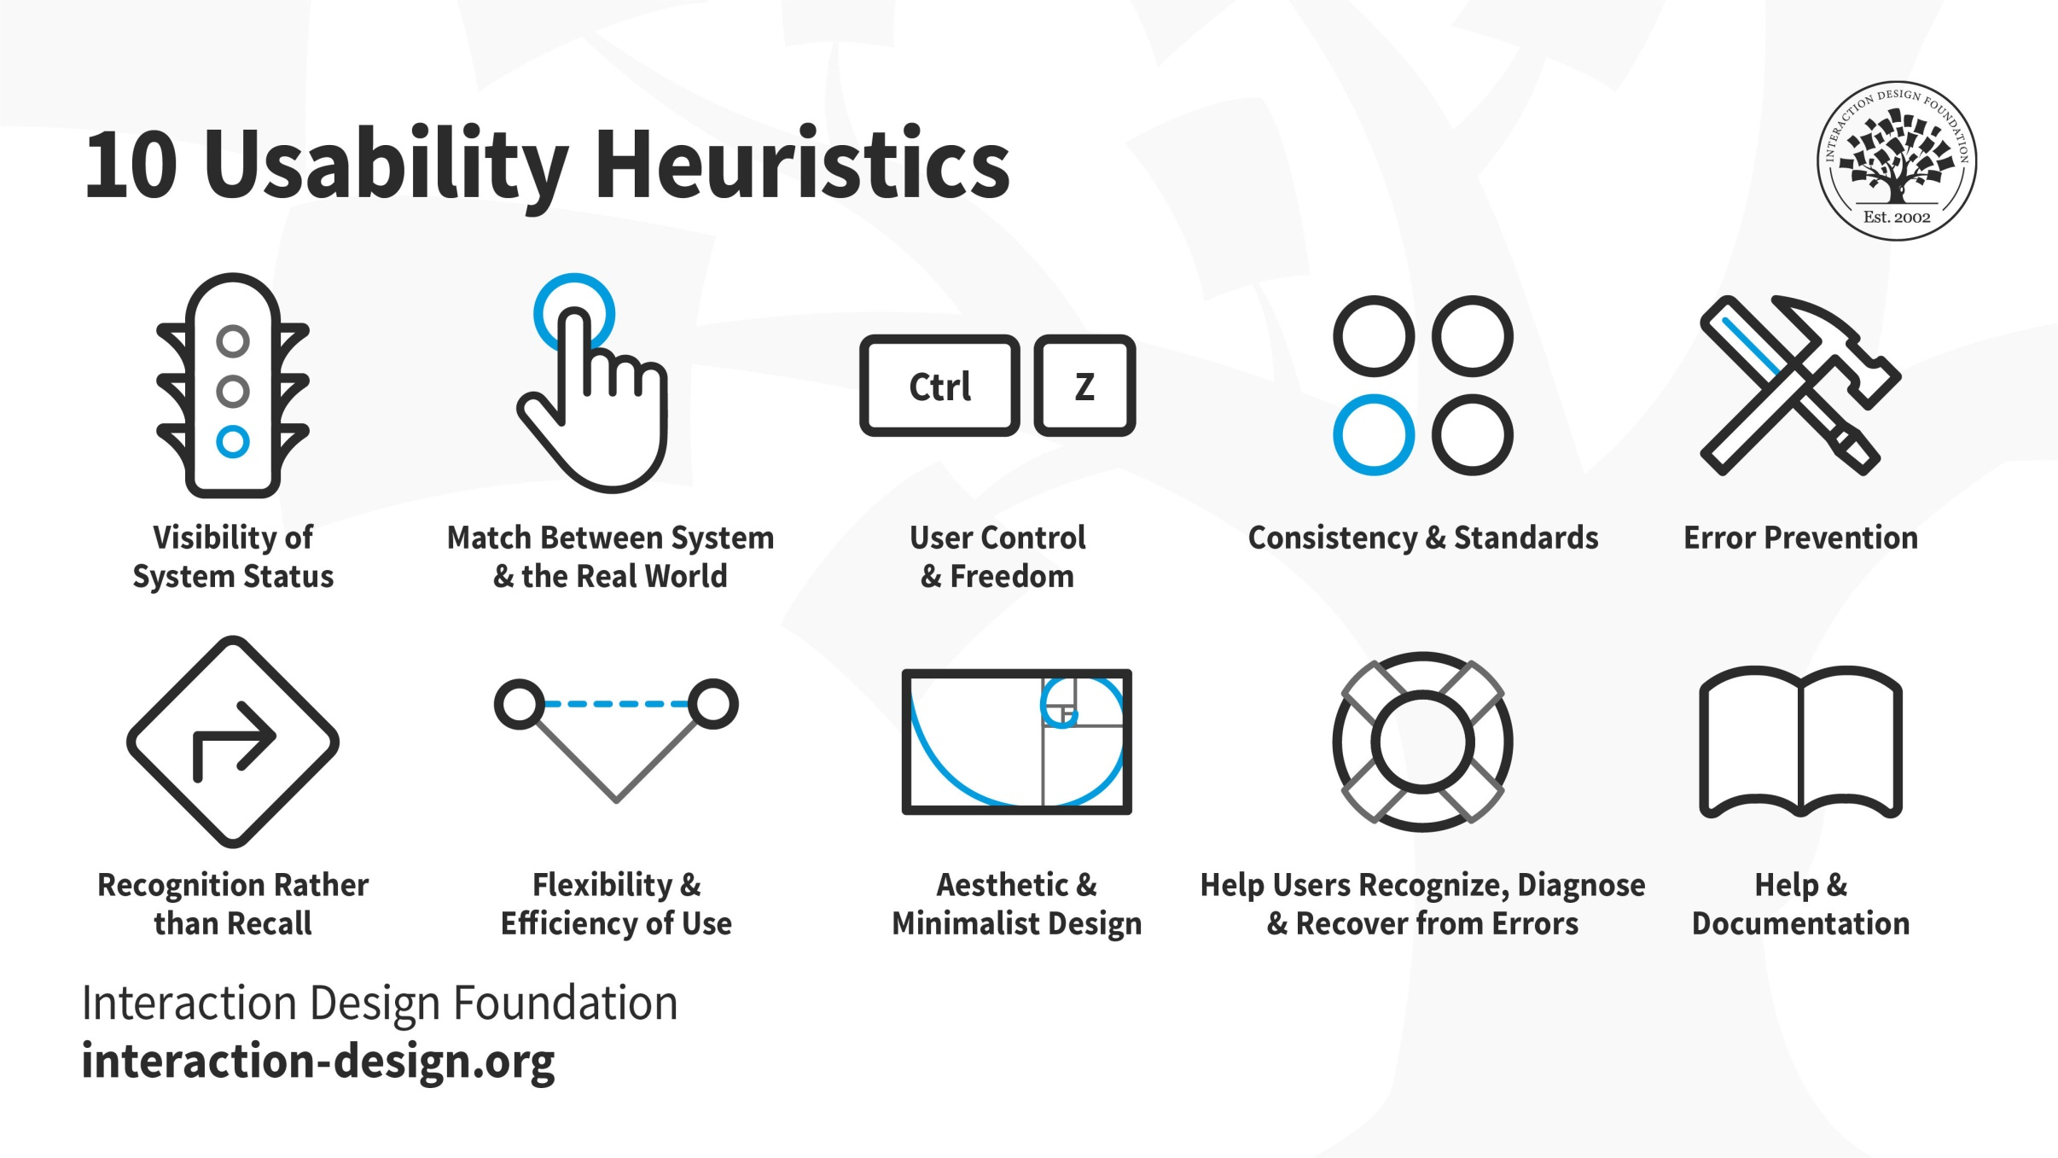

Slide 14

H1: Visibility of system status
The system should always keep users informed about what is going on, through (appropriate feedback within reasonable time)
Example: consider system response time (user must wait)
0.1 sec: no special indicators needed, why?
for longer delays, use percent-done progress bars
searching database for matches

Slide 15

H1: Visibility of system status
Keep users informed about what is going on Appropriate visible feedback
What mode am I in now?
What did I select?
How is the system interpreting my actions?

Slide 16
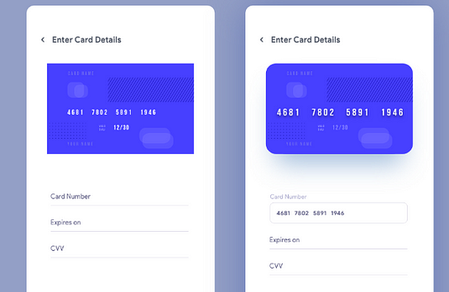
H2: Match between system & real world
The system should speak the users' language, with words, phrases and concepts familiar to the user, rather than system-oriented terms.
Follow real-world conventions, making information appear in a natural and logical order.

Slide 17
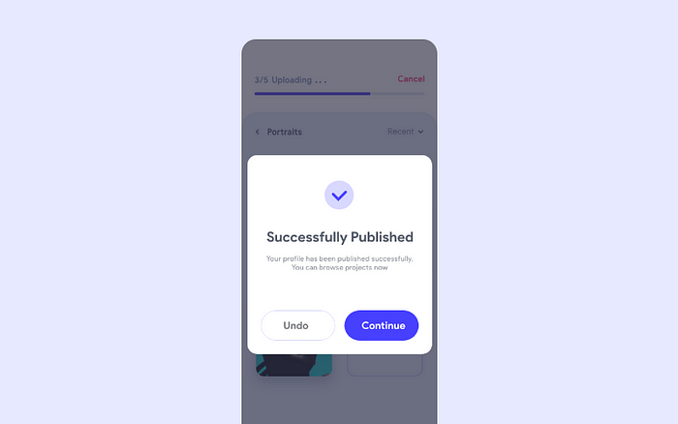
H3: User control & freedom
Users often choose system functions by mistake and will need a clearly marked "emergency exit" to leave the unwanted state without having to go through an extended dialogue. Support undo and redo.

Slide 18
H3: User control & freedom
“Exits” for mistaken choices, undo, redo Don’t force down fixed paths
Strategies:
Cancel button (for dialogs waiting for user input) Universal undo (can get back to previous state) Interrupt (especially for lengthy operations)
Quit (for leaving the program at any time) Defaults (for restoring a property sheet)

Slide 19
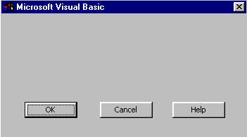
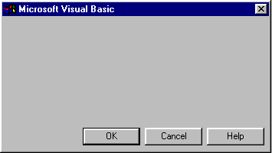
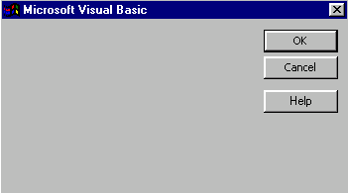
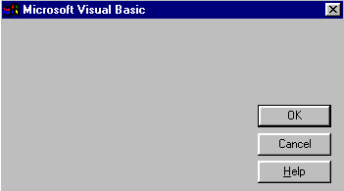
H4: Consistency & standards
Consistency of effects = predictability
Same words, commands, actions should always have the same effect in equivalent situations
Same visual appearance across the system (e.g., widgets)
e.g., not different scroll bars in a single window system

Slide 20
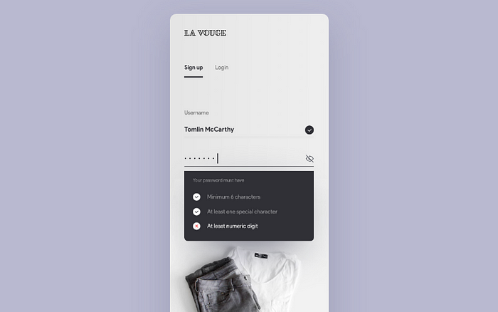
H5: Error prevention
Try to make errors impossible
Even better than good error messages is a careful design which prevents a problem from occurring in the first place. Either eliminate error-prone conditions or check for them and present users with a confirmation option before they commit to the action.

Slide 21
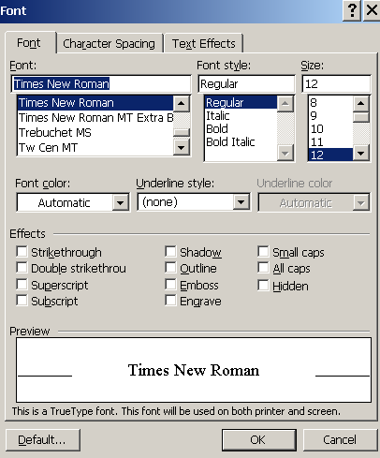
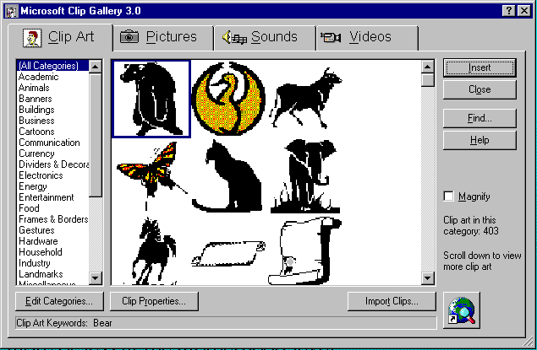
H6: recognition rather than recall
Computers are good at remembering things, people aren’t!
Minimize the user's memory load by making objects, actions, and options visible. The user should not have to remember information from one part of the dialogue to another. Instructions for use of the system should be visible or easily retrievable whenever appropriate.

Slide 22
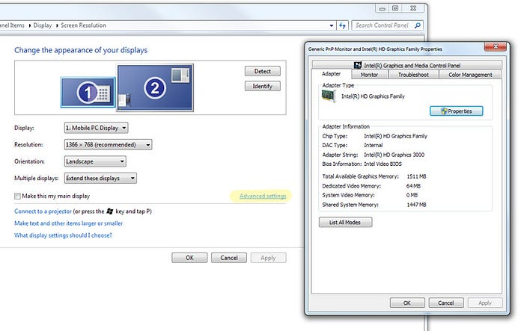
H7: flexibility and efficiency of use
Experienced users should be able to perform frequently used operations quickly
Strategies:
Keyboard and mouse accelerators

Slide 23
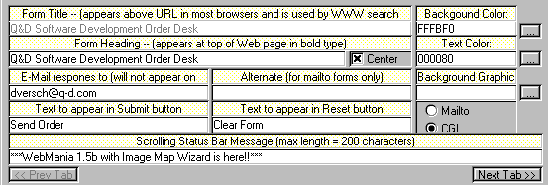
H8: aesthetic and minimalist design
Dialogues should not contain information which is irrelevant or rarely needed. Every extra unit of information in a dialogue competes with the relevant units of information and diminishes their relative visibility.

Slide 24
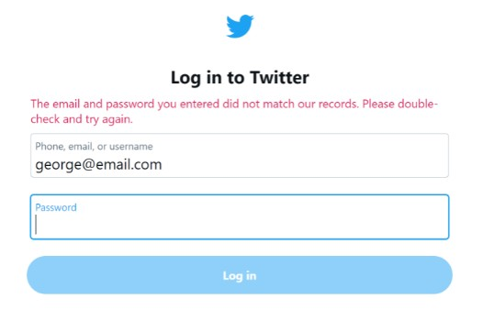
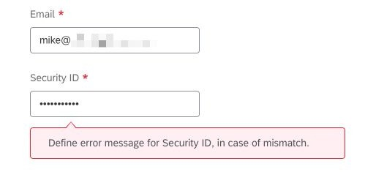
H9: help users recognize, diagnose, and recover from errors
Error messages should be expressed in plain language (no codes), precisely
Indicate the problem, and constructively suggest a solution.

Slide 25
H10: help and documentation
Help is not a replacement for bad design!
Simple systems: walk up and use; minimal instructions Most other systems:
Feature-rich
Some users want to become “expert” rather than “casual” users
Intermediate users need reminding, plus a learning path
Many users do not read manuals
Usually used when users are panicked & need help NOW Need online documentation, good search/lookup tools Online help can be specific to current context
Sometimes used for quick reference Syntax of actions, possibilities List of shortcuts

Slide 26
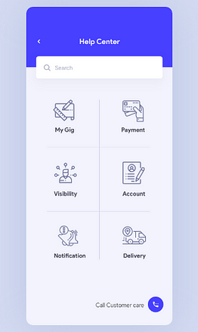
H10: types of help
Tutorial and/or getting started manuals
Short guides that people usually read when first encounter system Encourage exploration and getting to know the system Communicate conceptual material and essential syntax
Reference manuals
Used mostly for detailed lookup by experts
On-line hypertext Search / find Table of contents Index

